Slide 1

Move Clone
1.0.0
This asset is cloned via Alt - Mouse Move in Unreal Engine,
Or clone via Shift - Mouse Move in 3Ds Max
It is an asset created to have the same experience in Unity.

Slide 2
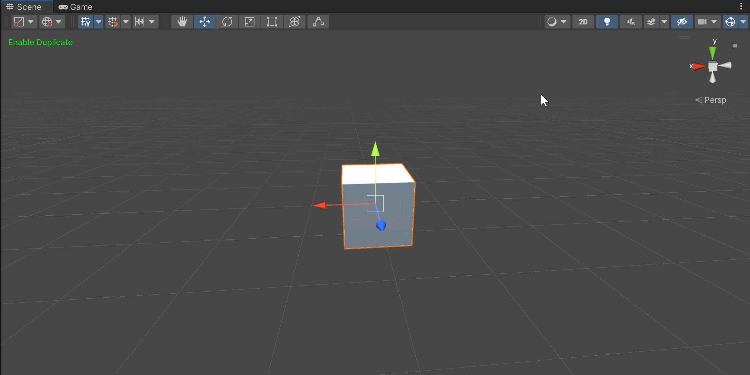
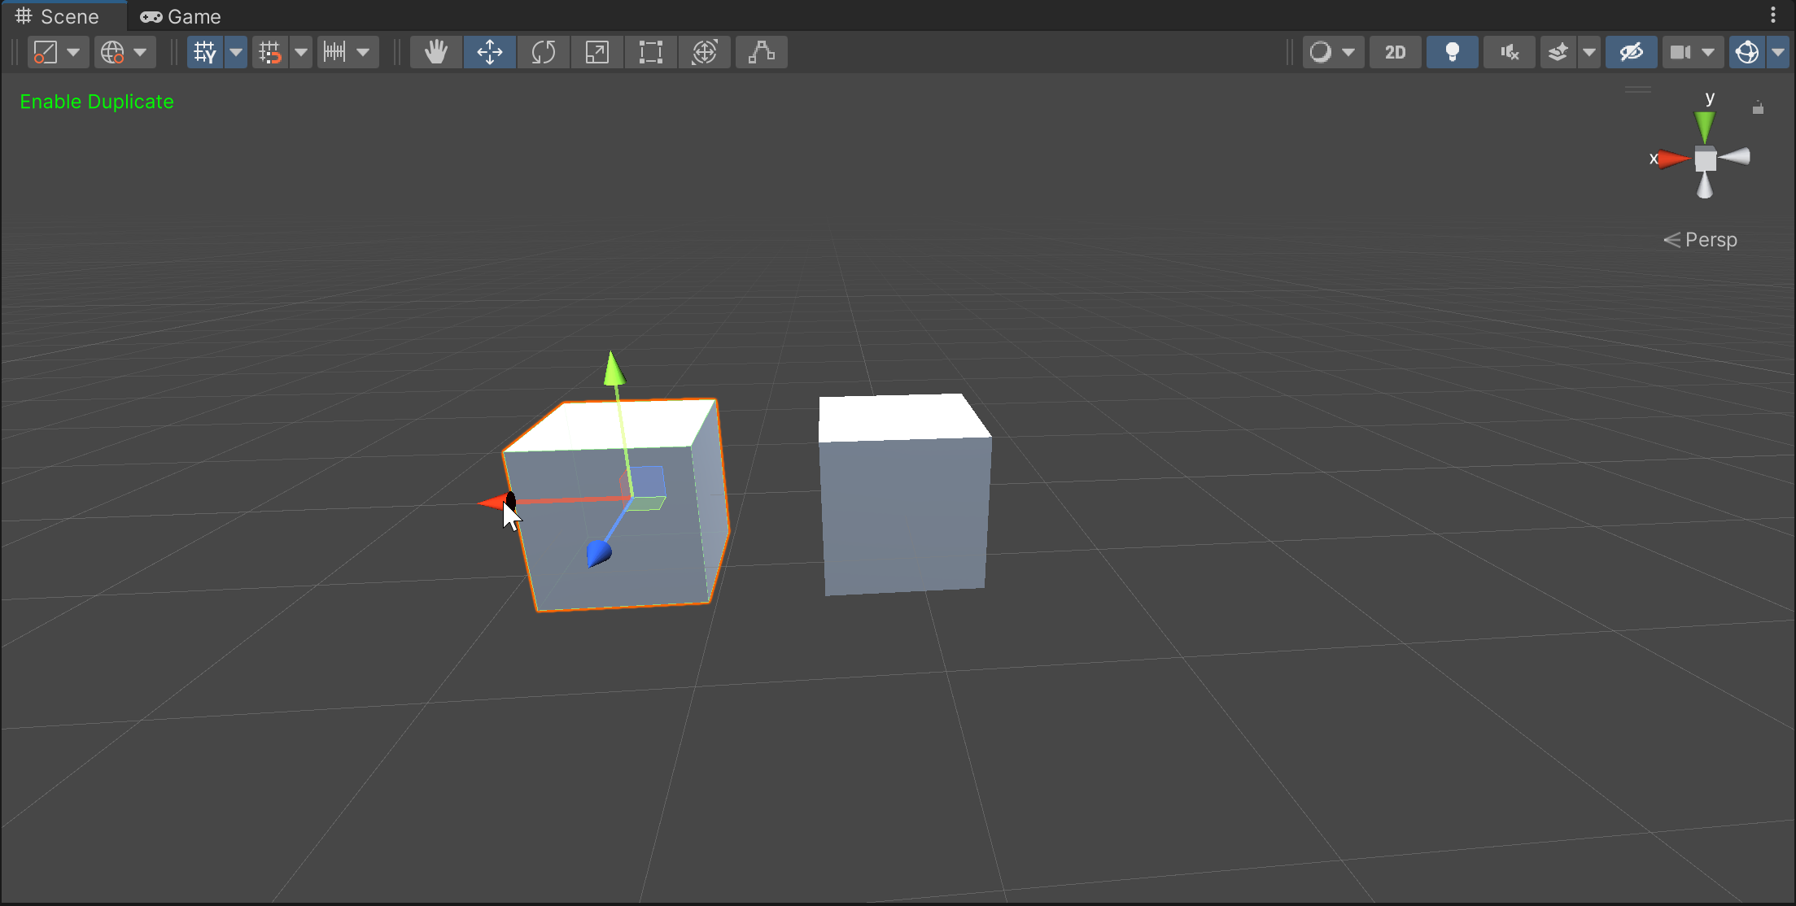
How to use :
When the Shift key is pressed while the object is selected, the text ‘Enable Duplicate’ is displayed.
If you move in this state, the object is duplicated.

Slide 3
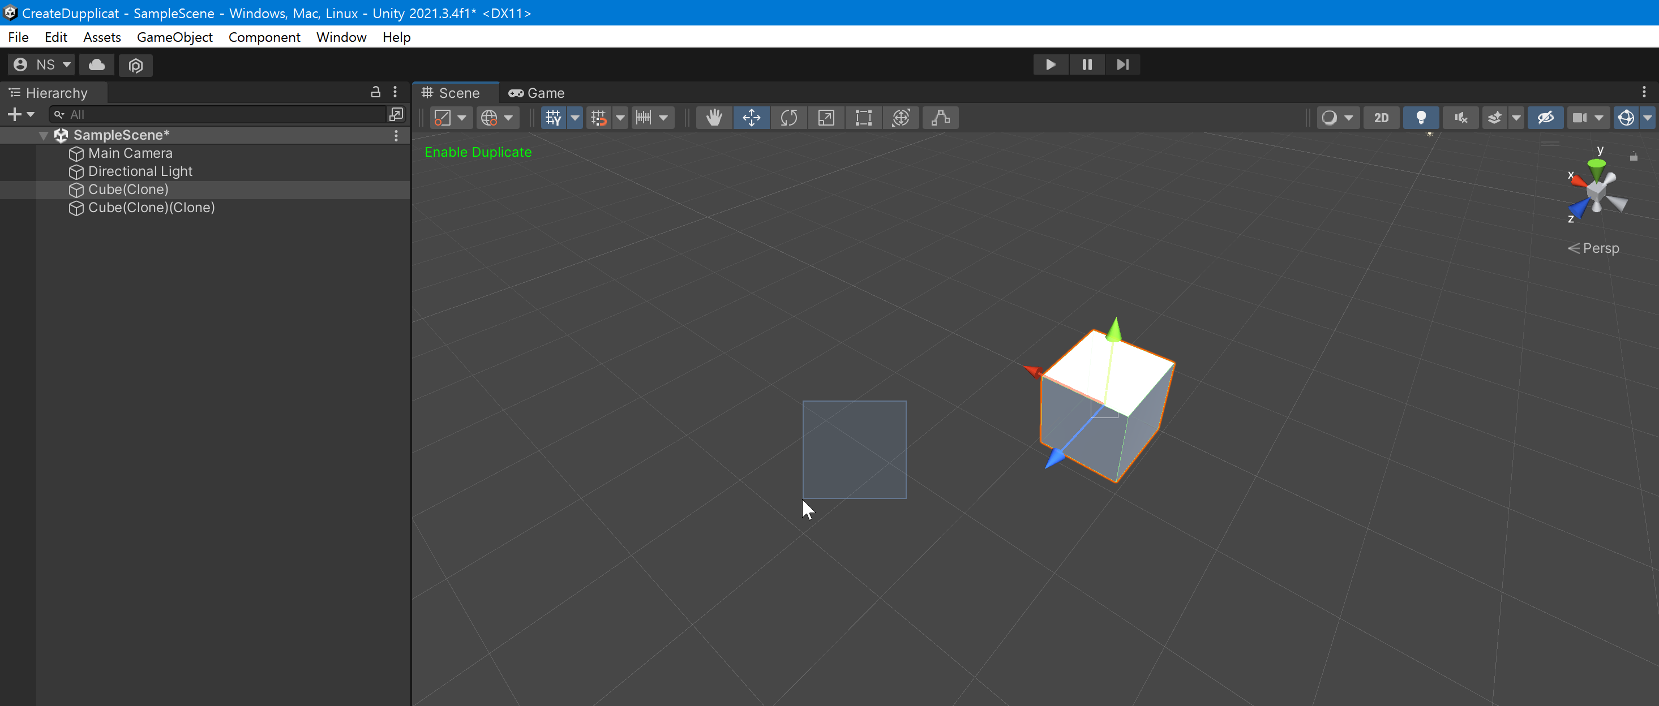
Caution :
If you drag an empty space while Duplicate is active,
an object is created in place.
I can't figure out a way to check that the gizmo is clicked, so at the moment it's a bug, but please consider it a function🤔

Slide 4
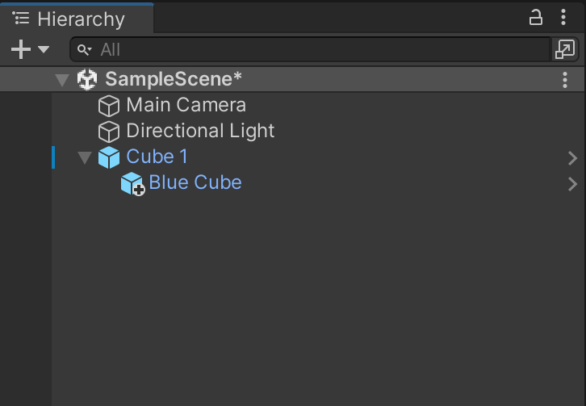
Caution :
No Override
Prefab duplicate does not duplicate the object (Cube 1) if there is an object that has not been overridden.

